Slide 1
How to read your statement
Expense Management

Slide 2
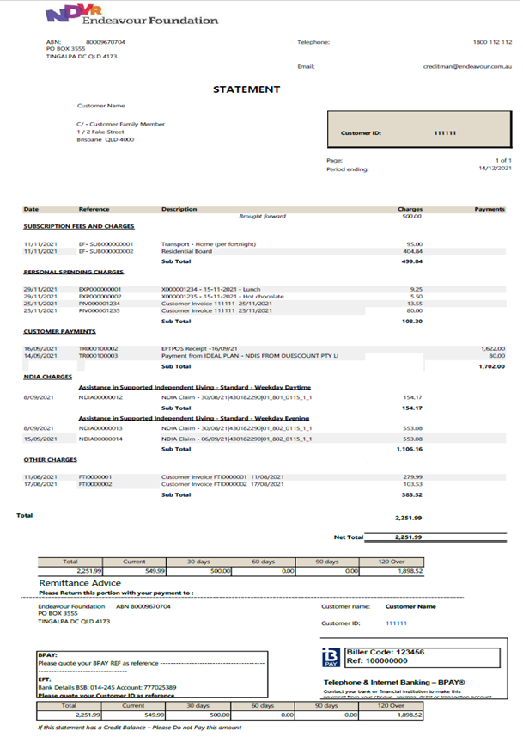
Your statement
Your statement has a few different sections. This guide will help to explain how to read your statement and what you need to do when you receive it.
Subscription fees and charges This section shows your charges for residential rent & board services.
It also shows your transport fees.
Personal spending charges
This section shows all the customer’s personal spending.
You can see the details of these transactions, including the receipts, on the ProMaster website.
Customer payments These are payments made during the month. This includes both payments from Financial Administrators or Plan Managers.
NDIA charges
NDIA Charges are claimed by Endeavour Foundation via the NDIA Portal
Other charges This section will contain any other charges.
Remittance advice
These are a few ways you can make payment on your account. See next page for more info. If you see any charges over 120 days please contact us.

