Slide 1
How to pay your account
Expense Management

Slide 2
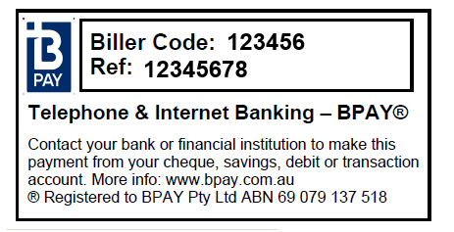
Paying your account
You can pay your account several different ways
1) Call 1800 112 112 to call and make a payment with credit card over the phone
2) Pay via BPAY using the Biller Code and Reference Number on your statement.
This may take up to 3 days to process
3) Pay via EFT Bank Transfer using the BSB and Account Number provided. Please use your Customer ID as a reference.

